Slide 1
Radiative convection simulations in CV disks
Axel Brandenburg (Nordita) & Upasana Das (JILA)
1980 – 1990: Convection as a source of effective disk viscosity
  Vila+78, Bath+Pringle81, Meyer+Meyer-Hofmeister81
1990 – 2000: disk viscosity from MRI, convection unimportant
  Stone+Balbus96
Since 2010: MRI with radiation → convection on upper branch

Slide 2
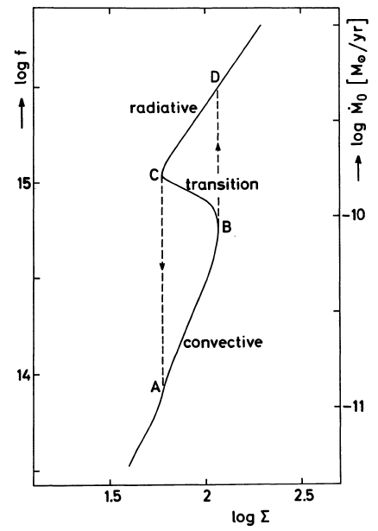
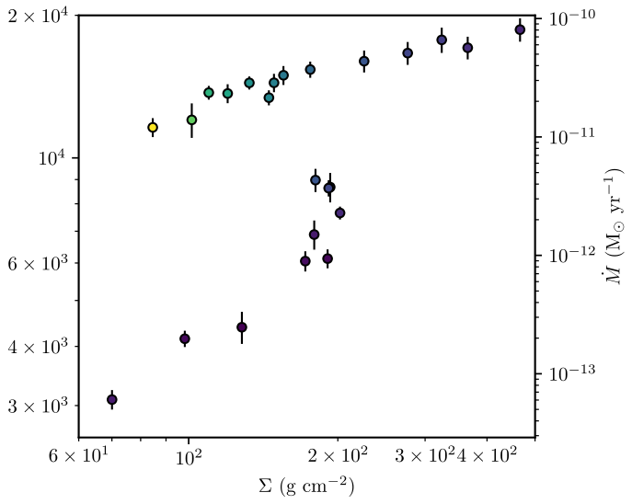
CV disks now & then: agreement!
Normally: slow → less active
Slow: large P_{rot}, large Rossby
Coleman+18
Meyer+Meyer-Hofmeister81

Slide 3
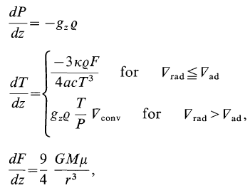
Convective flux & superadiabatic gradient
How well is mixing length theory confirmed?
Convective flux proportional to superadiabatic gradient?
Radiative & convective layers?
Viscosity parameterization?
Vertical heating profile?
Meyer+Meyer-Hofmeister81

Slide 4
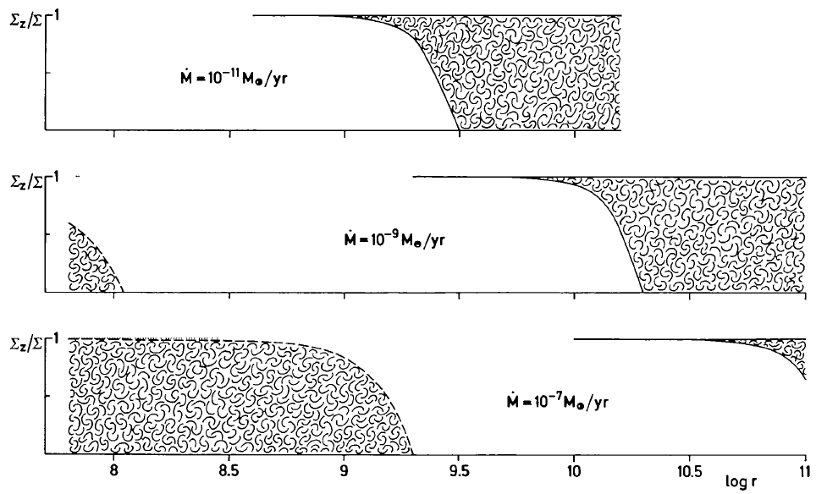
Convective layers in Meyer+Meyer-Hofmeister (1981)
Meyer+Meyer-Hofmeister81

Slide 5
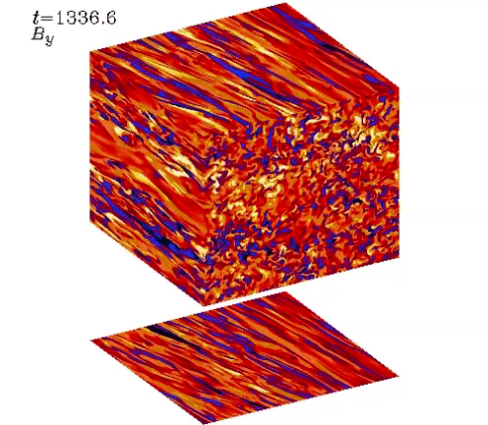
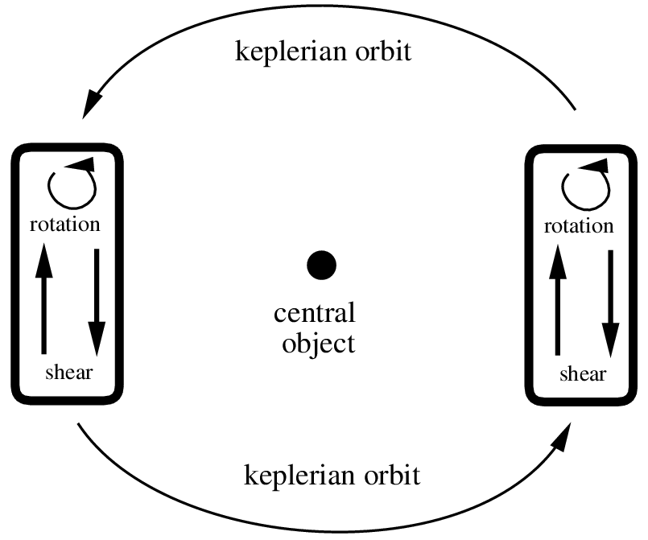
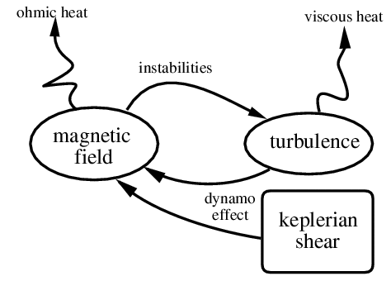
Dynamo input: shearing sheet simulations
Wisdom & Tremaine (1988)
Balbus & Hawley (1991)
Brandenburg et al. (1995)
Stone et al. (1996)
….
Hirose et al. (2014)
Coleman et al. (2018)
512³ resolution

Slide 6
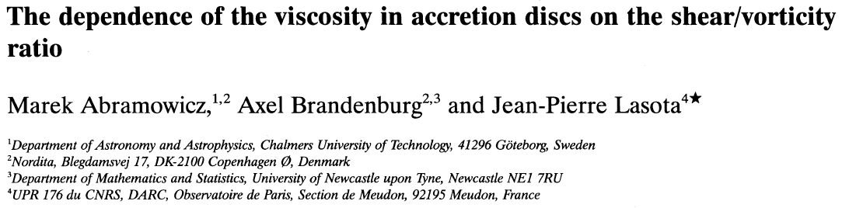
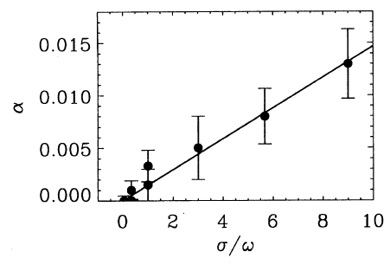

Vertical stratification
Shear & vorticity
Main characteristics of disk turbulence

Slide 7
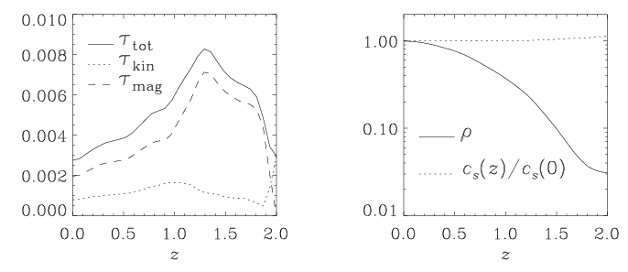

Vertical stratification
Brandenburg et al. (1996)
z-dependence of

Slide 8
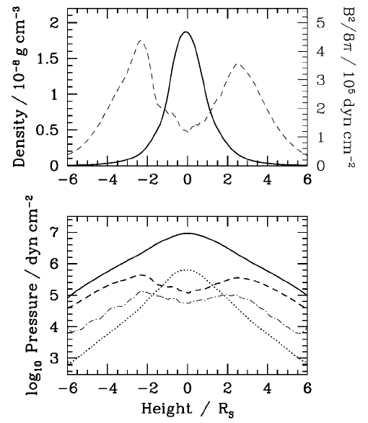
Heating near disc boundary
weak z-dependence of energy density
where
Turner (2004)

Slide 9
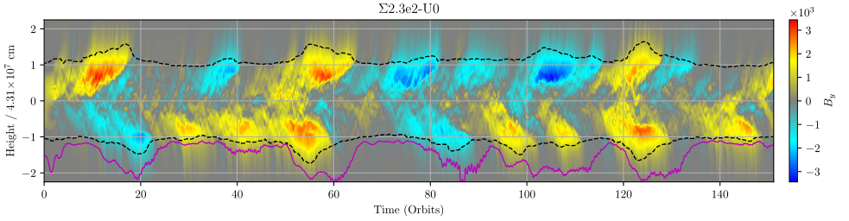
Vertical structure not that simple
Coleman+18
Structure affected by MRI
All layers somehow turbulent
Convective layers unclear, cannot verify mixing length theory

Slide 10
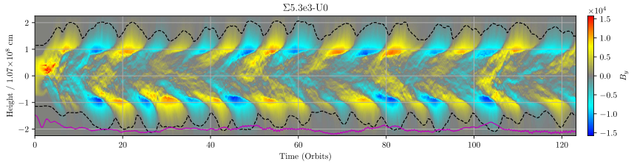
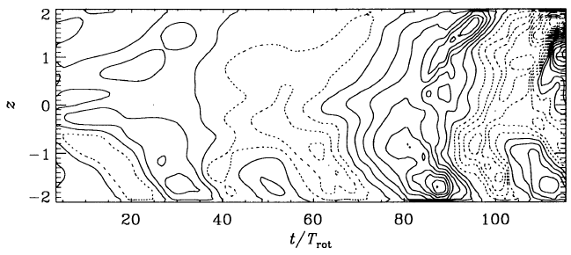
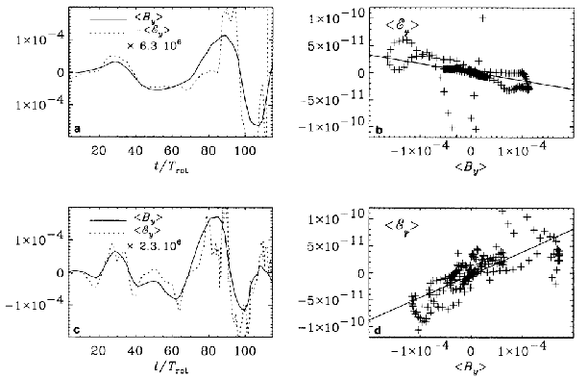
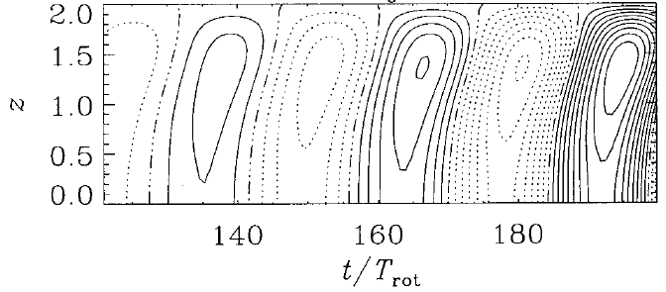
Cycles understood in terms of mean field dynamo theory
Coleman et al. (2018)
Successfully modeled through horizontally averaged induction equation
◊ α<0
Brandenburg et al. (1995)
cycle frequency
for Kepler
relevant wave number
Brandenburg & Subramanian, Phys. Rep. (2005, 417, 1-209)

Slide 11
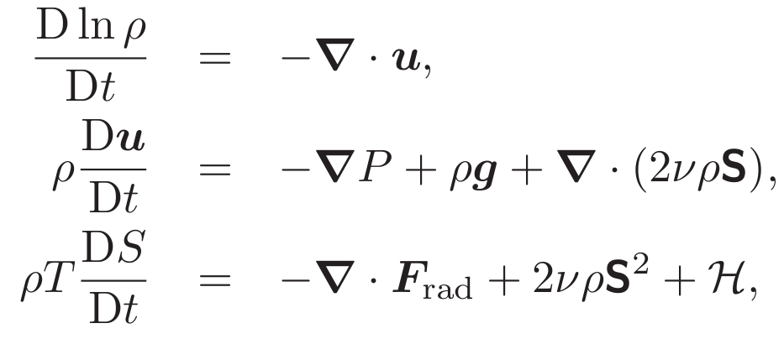


Now radiation: hydro with prescribed heating H(z)
Shearing box
Gray rad transfer
22 – 26 rays in 3D
Σ = fixed
box profile for H
→ Mdot = fixed
10¹⁰cm from WD
Ω = 12 ks⁻¹

Slide 12
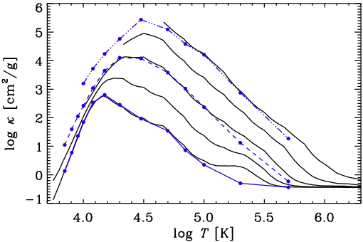
OPAL vs. old Cox & Stewart opacities
2 branches
Rising branch important for convection
Suitable differences less important?
Rising branch from H- opacity at low T
Simpler model?
10⁻³ g/cm³
10⁻⁵ g/cm³
10⁻⁷ g/cm³

Slide 13
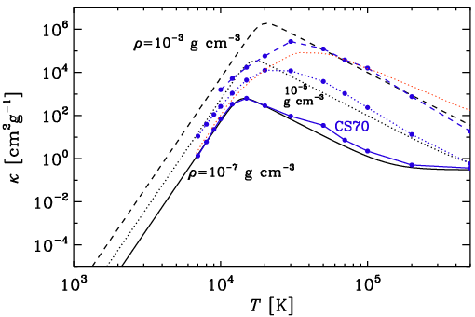


Essential features captured by analytic formula
Kr: a=1, b=-7/2
H⁻: a=0.5, b=+10…

Slide 14

Interpretation of the slopes
Radiative flux:
with
Kramers’ opacity:
Nonconvecting solution (F_{rad}=const, T_{top}= 0.84T_{eff})
Polytropic index:
Brandenburg (2016)
>1.5 (→ stable)
Axel Brandenburg
CU-Boulder, Colorado
Nordita, Stockholm

Slide 15
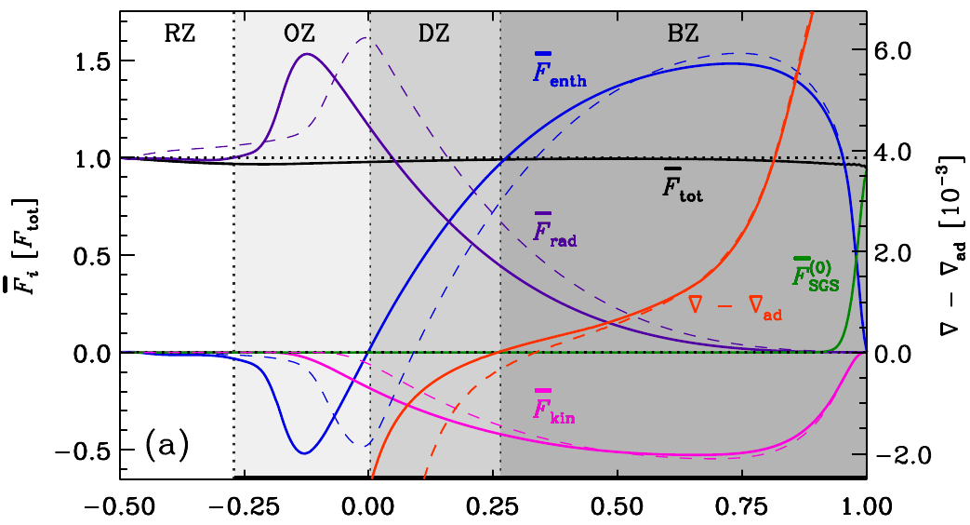
Stellar simulations (Kapyla+17)
Extended subadiabatic layer
Yet upward enthalpy flux
But: im mixing-length theory, enthalpy flux modeled as proportional to superadiabatic grad!
To rethink stellar convection models
Global models: no giant cell convection!
Brandenburg (2016)
Axel Brandenburg
CU-Boulder, Colorado
Nordita, Stockholm
Notes:
Solar Focus on Convection, 5 December 2017, extend for Matilsky discussion of April 12, 2018

Slide 16
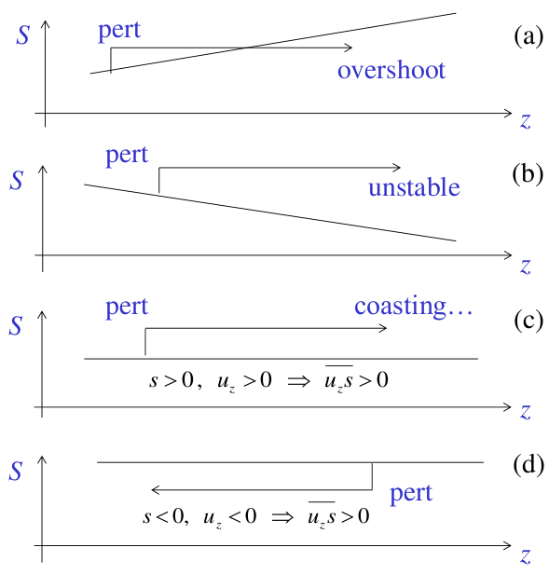

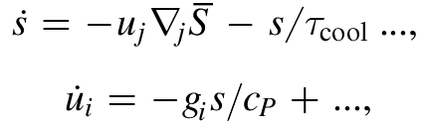
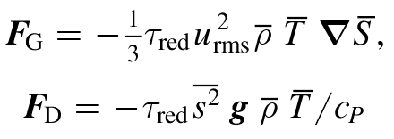
Nonstandard mixing-length term
tau approximation
Plays a role in stellar convection
Also seen in stellar simulations
But here more prominent!
Brandenburg (2016, ApJ 832, 6) → entropy rain
energy & momentum eqn
gradient & Deardorff terms
Axel Brandenburg
CU-Boulder, Colorado
Nordita, Stockholm
extra nabla term in standard MLT
16

Slide 17
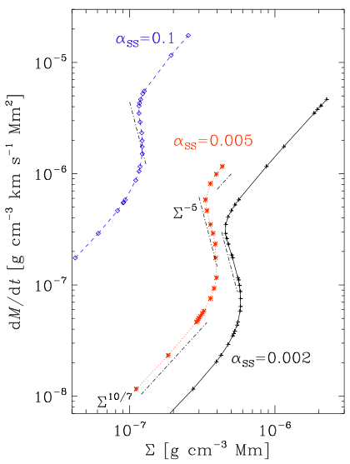
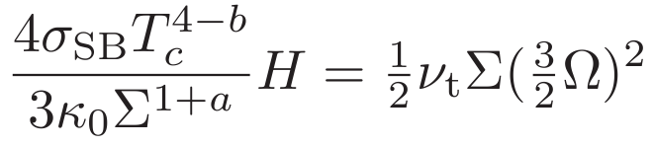

1-D radiative equilibria
Integrate inward
Analytic solution in terms on lnP
Integrate z=z(lnP)
Compare w/ integrated solution

Slide 18
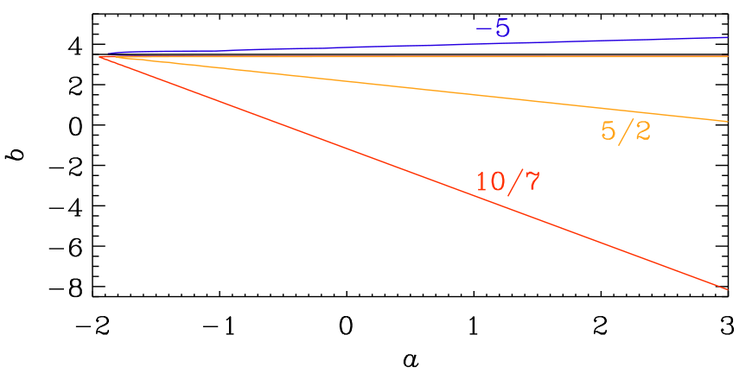
Slopes of the branches

Slide 19
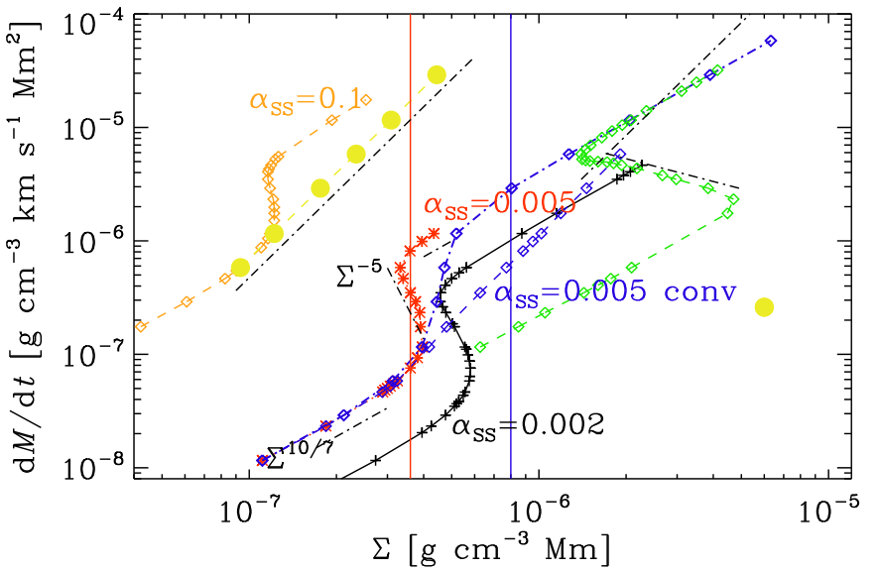
More solutions
Different α
SS=Shakura & Sunyaev
Look at solutions for fixed Σ
Convection removed S shape

Slide 20
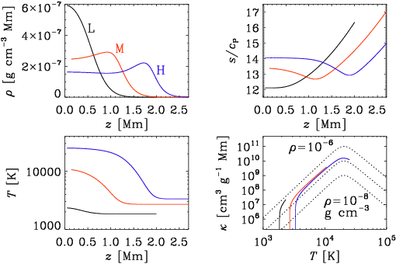
Three 1-D radiative equilibrium solutions
Integrate inward
Analytic solution in terms on lnP
Integrate z=z(lnP)

Slide 21
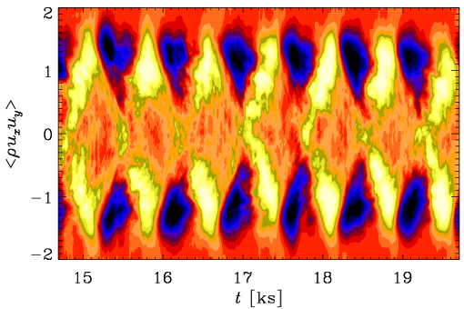
3-D convection solutions
Oscillating stress
Near-cancelation
Not epicyclic
Unclear whether just p-mode
Energy transport?

Slide 22
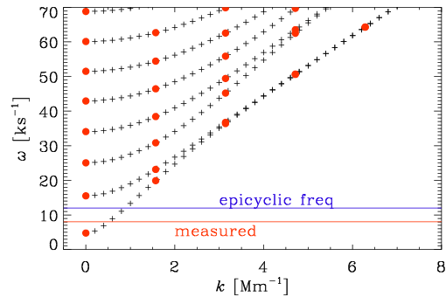
Intermediate solution: mean stratification
All p-mode frequencies
Degenerate at high k
Lowest p-mode?
degenerate at high k?
(preliminary work!)

Slide 23
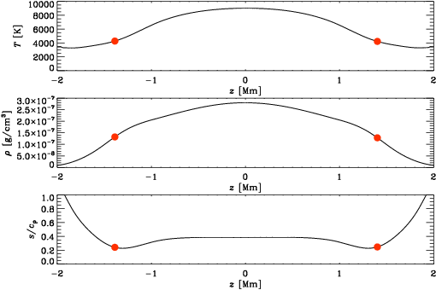
Intermediate solution: mean stratification
Nearly isentropic near midplane
Small density changes within bulk

Slide 24
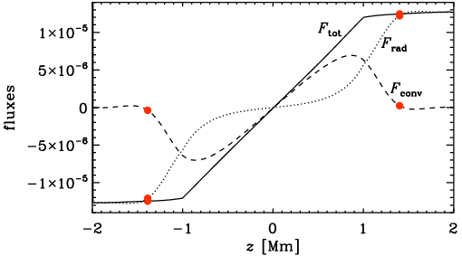
Intermediate solution: mean stratification
Significant convective flux near midplane!
Not explained by super-adiabatic gradient!

Slide 25
Conclusions
Heating from MRI not proportional to local pressure
The remarkable agreement between early mixing-length models and new simulations accidental
Kramers-type opacities help understanding underlying physics
  Convective instability
  Viscous instability
Oscillations even without magnetic fields or dynamo
Convective flux has contribution from Deardorff flux

Slide 26
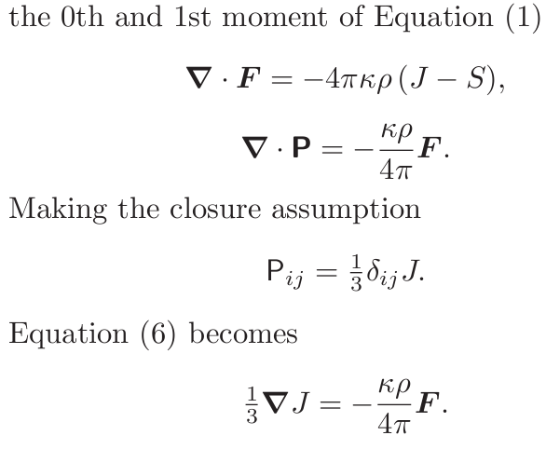
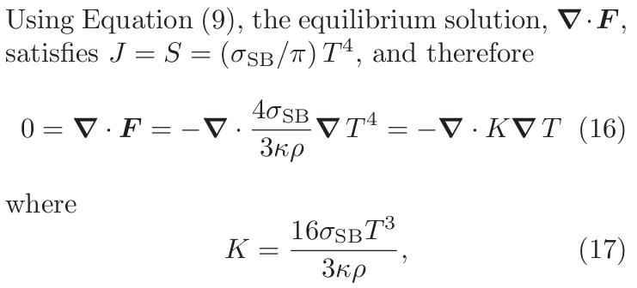
Backup: why optically thick = thin in equilibrium
Axel Brandenburg
CU-Boulder, Colorado
Nordita, Stockholm

